Slide 1
AccessScience Overview
A Tour of the Site and Content

Slide 2
AccessScience contains thousands of articles on all science disciplines, written by world-renowned scientists.
Notes:
1. Articles
AccessScience articles are written by world-renowned scientists, including 42 Nobel prize winners. The articles are skillfully edited to engage and inform, bridging the gap from the classroom to independent STEM research.
PAIN POINT: Faculty & librarians often ask for credible, authoritative science sources written at an accessible level, for students who need resources to bridge the gap between science textbooks and primary research articles.

Slide 3
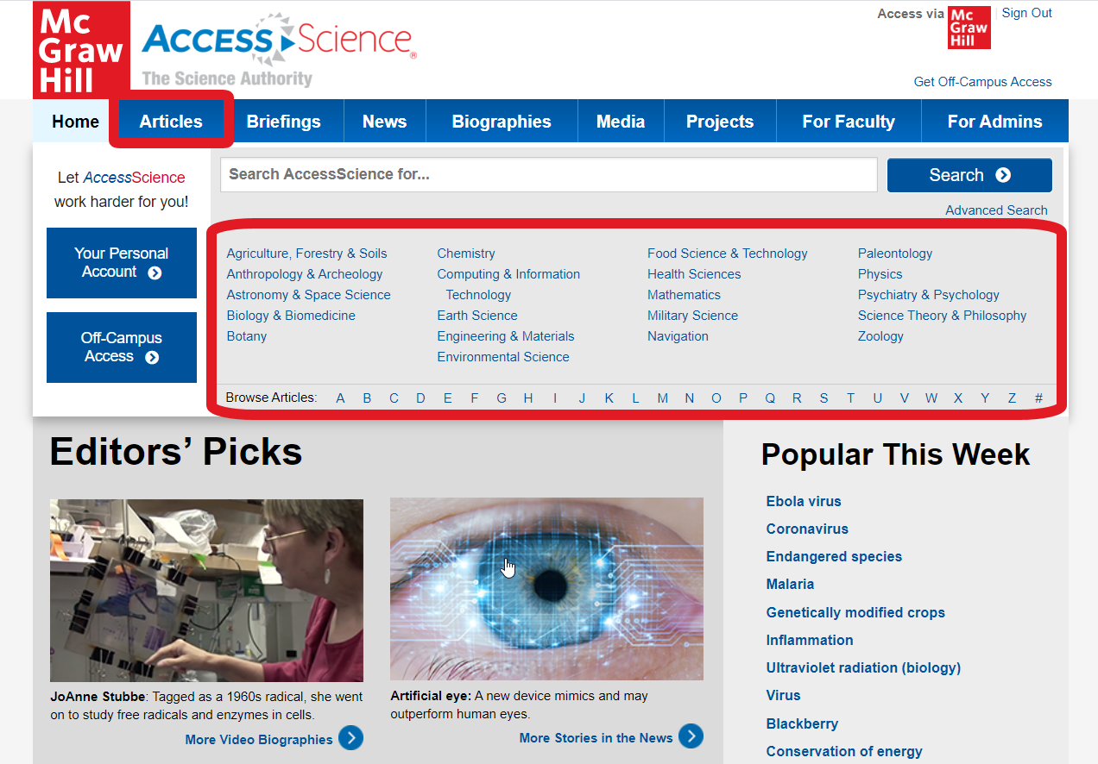
Authoritative Articles
Browse through articles by discipline for up-to-date content
AccessScience.com
Notes:
Use the LINKS on the homepage to browse available articles by discipline. AccessScience covers all major scientific disciplines and articles are continuously reviewed and updated.
[Click on a subject:}
Biological Sciences/Health Sciences= Biology & Biomedicine; SUBTOPIC= Cell Biology
Physical Sciences= Physics; SUBTOPIC= Classical Mechanics
Point out that each SUBJECT has a range of SUBTOPICS, showing the depth of content on the site as well a the breadth.
PAIN POINT: Librarians are often looking for a broad science database that covers many disciplines, AccessScience covers everything from larger disciplines like Biology & Biomedicine to more niche disciplines like Paleontology and Zoology.

Slide 4
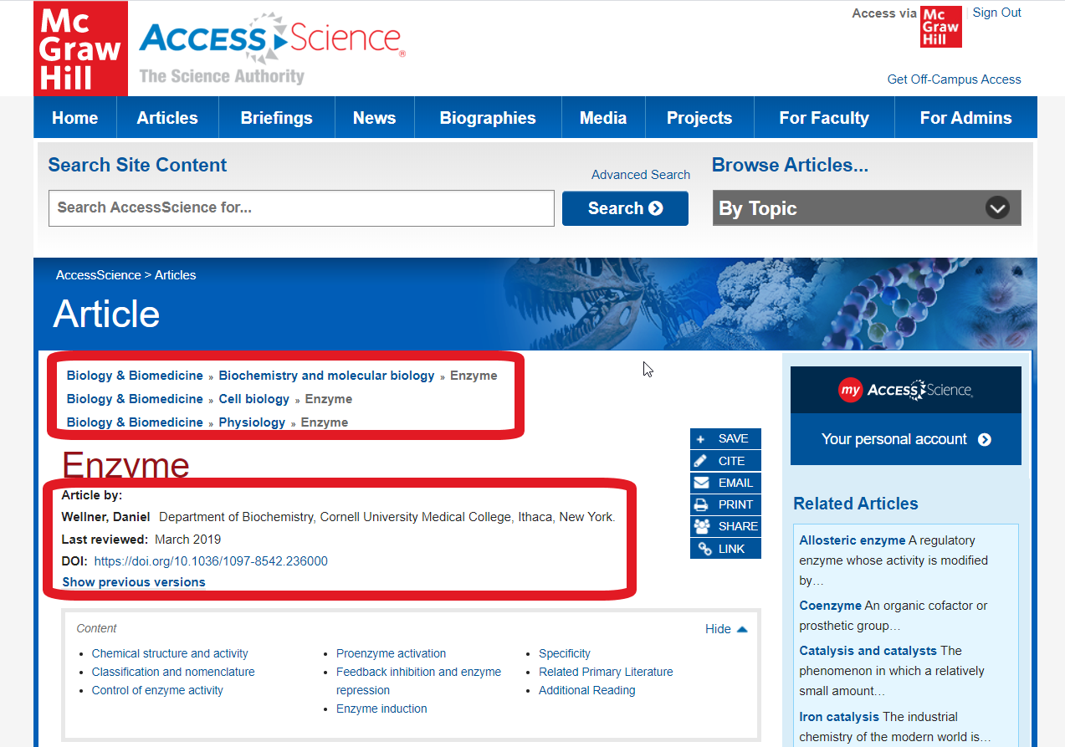
Authoritative Articles
View information on authors and their institutional affiliation
AccessScience.com
Notes:
[From the SUBTOPIC list on the last slide, open an ARTICLE:]
Biological Sciences/Health Sciences= Enzyme
Physical Sciences= Conservation of energy
Information on the AUTHOR of an article and their institutional affiliations are listed underneath the article title to easily show the credibility of the article contents.
Also in this section is the DATE the article was last reviewed, a DOI LINK for persistent access, and links to all of the SUBTOPICS where this article is listed.
PAIN POINT: Faculty & librarians are often looking for credible sources they can point students to for research, and are teaching students to think critically about the authority of content they read. AccessScience makes it very easy to find and confirm the credentials of our authors.

Slide 5
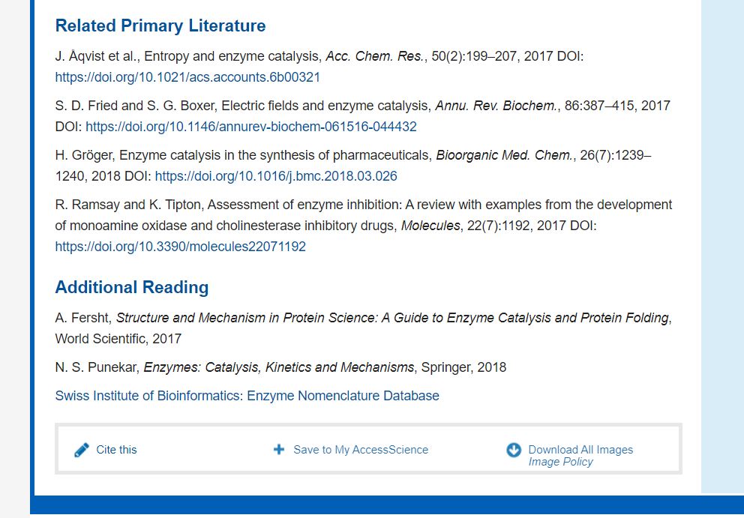
Authoritative Articles
Use the Related Literature section to link to curated primary literature and other resources
AccessScience.com
Notes:
[Scroll through the article to the RELATED PRIMARY LITERATURE section]
AccessScience serves as a gateway to scientific knowledge, by offering LINKS to primary research material at the end of articles.
These references are updated whenever the article content is updated to keep them current and representative of newer work being done on the topic.
AccessScience editors also try to choose Open Access articles whenever possible so that more users can get access directly to the primary works through these links.
The ADDITIONAL READING section contains additional books and websites that are useful for gaining a deeper knowledge on the topic.
PAIN POINT: Faculty & librarians often direct students to find additional sources for a research paper or project, and AccessScience helps with providing a curated list of primary literature to get students started, while also being an authoritative and citable source itself.

Slide 6
Learn about the latest scientific discoveries and breakthroughs with regularly updated briefings and news stories.
Notes:
2. Briefings & News Stories
Briefings and curated news stories cover timely, relevant concepts in science and technology and provide a great starting place for research topics ideas.
PAIN POINTS: Faculty are often looking for relevant newsworthy content to include in their courses that are authoritative and written in an accessible style. Faculty & librarians also often help students with selecting topics for research papers or projects and are looking for sources to recommend that allow students to browse through potential topics to find something of interest.

Slide 7
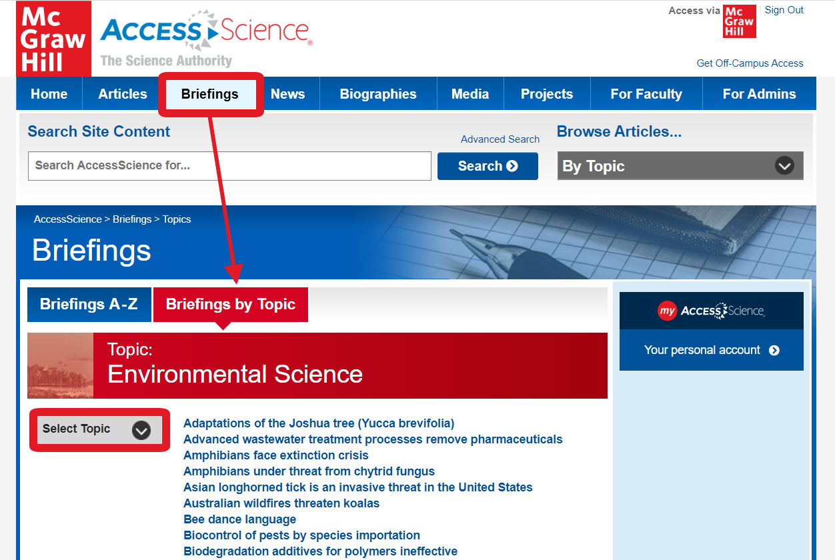
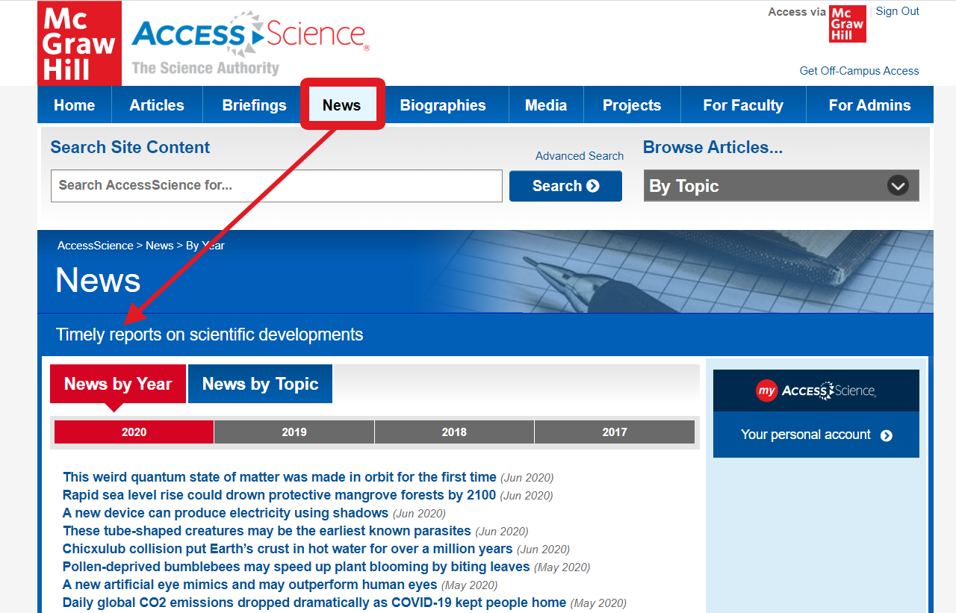
Timely Briefings & News
Browse through briefings and news stories by discipline or date
AccessScience.com
Notes:
[Click on BRIEFINGS tab, and select “Briefings by Topic”:]
Biological Sciences/Health Sciences= Health Sciences
Physical Sciences= Engineering & Materials
In addition to the in-depth articles, AccessScience also contains BREIFINGS, which are shorter, more topical pieces on new discoveries and events, written by AccessScience editors, and NEWS STORIES, which are a curated collection from Science News Magazine, an independent source of accurate scientific information.
Both BREIFINGS and NEWS STORIES can be browsed by TOPIC and are a great resource for students searching for a topic for a paper or project.
PAIN POINT: Faculty & librarians often need resources for students selecting research topics, students can use the browsable lists to find something that is interesting and relevant to them.

Slide 8
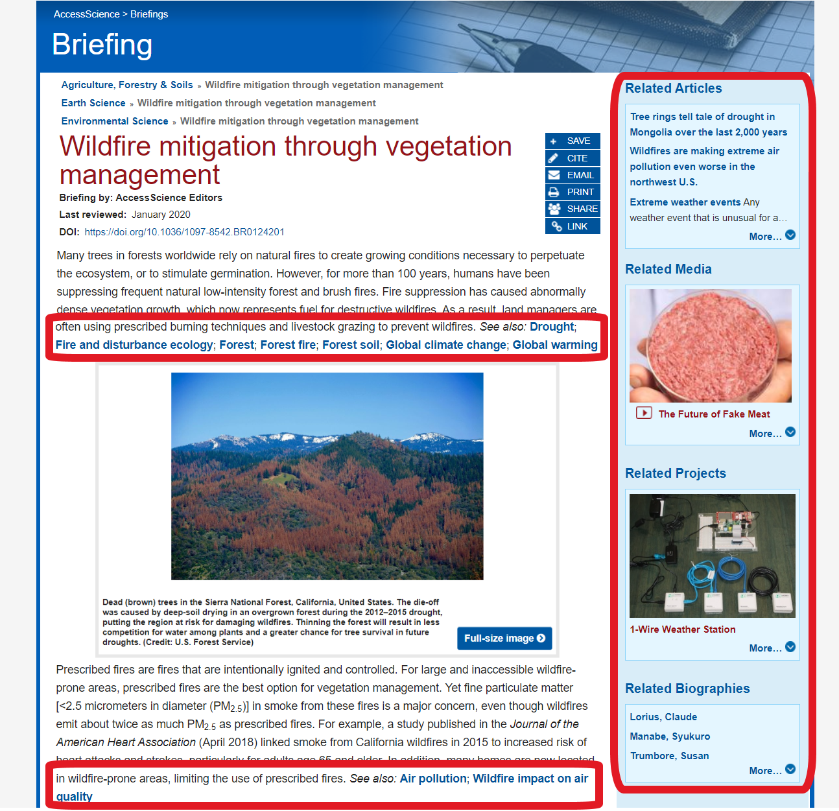
Timely Briefings & News
Fully explore a topic with links to related content on AccessScience
AccessScience.com
Notes:
[From the TOPIC in the previous slide, open a BREIFING:]
Biological Sciences/Health Sciences= Measles can cause loss of immune-system memory
Physical Sciences= Hydrogen fuel cell-powered marine vessels
The RELATED CONTENT SIDEBAR creates further connections between content within AccessScience. Appearing on all content types, this sidebar highlights additional articles, briefings, videos, biographies and projects that are relevant to the content being viewed.
“SEE ALSO” links at the end of paragraphs provide additional content suggestions for a deeper understanding of topics being discussed.
PAIN POINT: Faculty & librarians often find that students have trouble selecting a topic for a research paper or project that has an appropriate scope and is not too broad or too narrow. Briefings and News Stories link out to additional external content and content on AccessScience to help students explore a topic further and see what information is available to support their topic choice.

Slide 9
Access curated collections of multimedia to engage with scientific concepts and the work of well-known scientists.
Notes:
3. Multimedia
AccessScience contains over 19,000 images, videos and animations to illustrate key scientific concepts in engaging and meaningful ways, including a collection of over 3,000 biographies and video biographies highlighting the work of award-winning scientists.
PAIN POINT: Faculty often need to find images, animations, videos, and other supplemental media to incorporate into lectures and assignments. Librarians often help students find similar resources that they need to incorporate into their research projects.

Slide 10
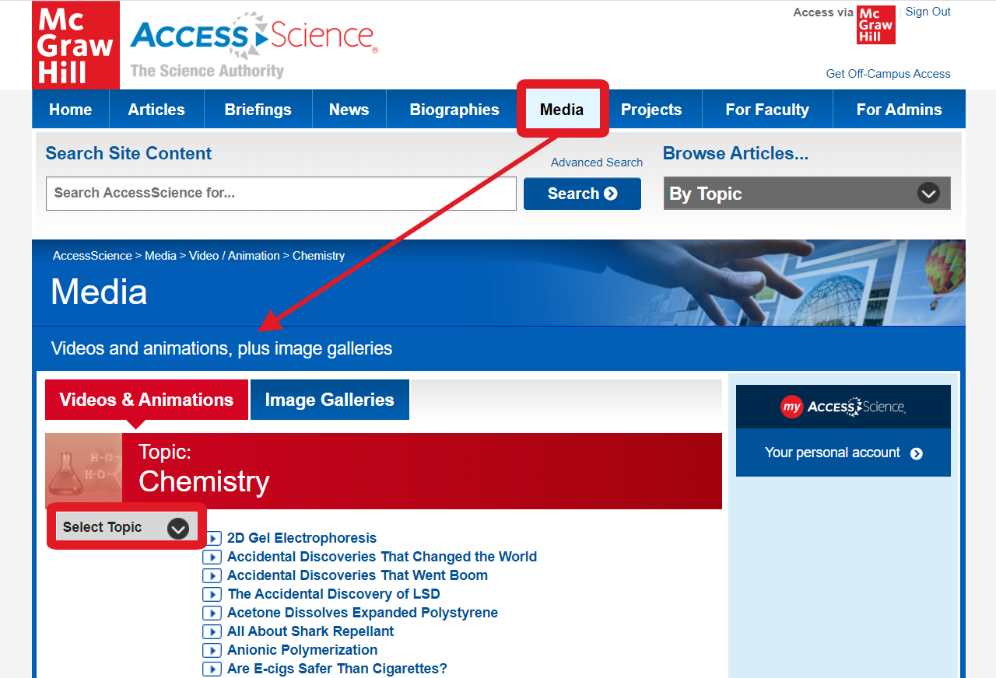
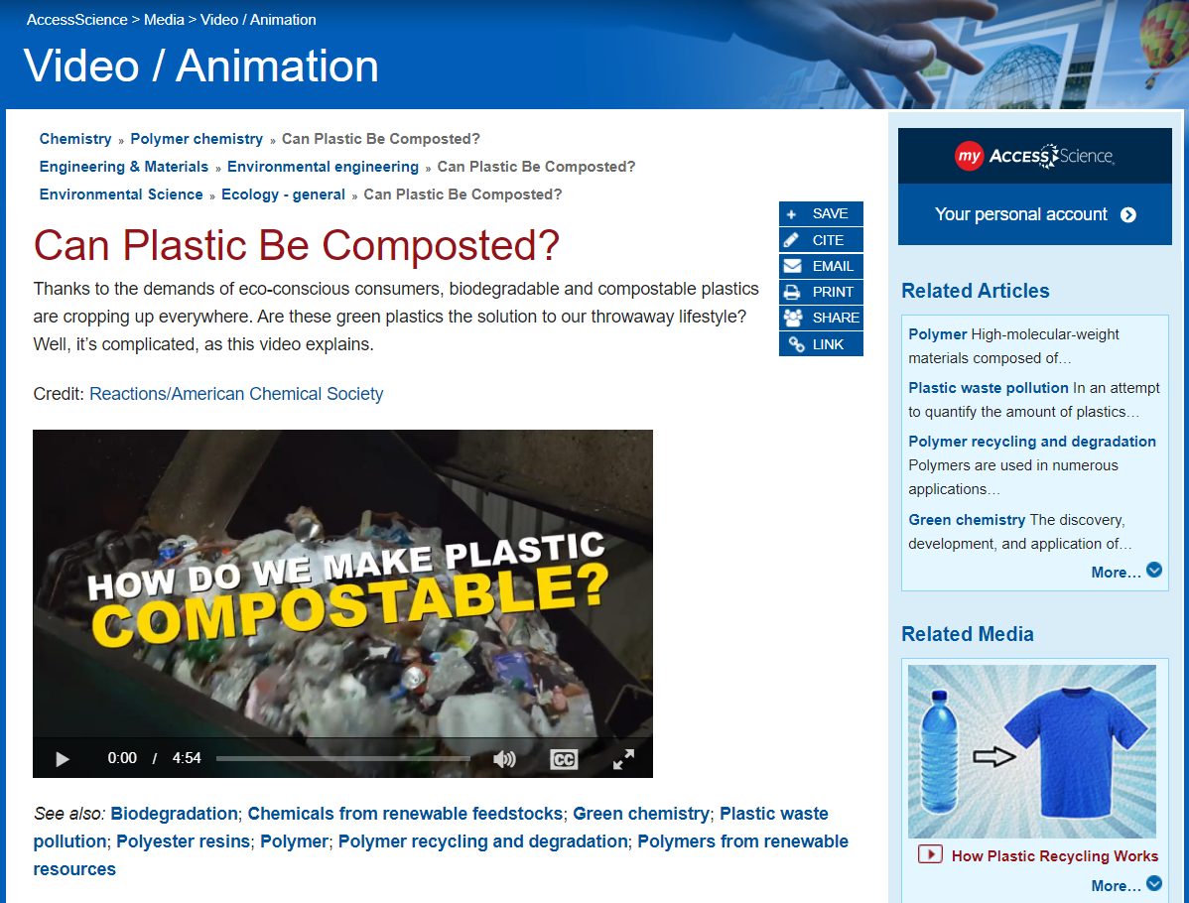
Engaging Multimedia
Browse videos and animations illustrating scientific concepts
AccessScience.com
Notes:
[Click on MEDIA tab, select a TOPIC, and open a VIDEO:]
Biological Sciences/Health Sciences= TOPIC= Biology & Biomedicine; VIDEO= The Brain Science of Making Decisions
Physical Sciences= TOPIC= Chemistry; VIDEO= The Chemistry of Fireworks
AccessScience videos and animations illustrate key concepts and answer scientific questions in engaging ways.
All videos are fairly short, with most around 3 to 5 minutes, and include closed captioning.
Direct links to videos can be easily shared using the content tools to the right of the video title.
PAIN POINT: Faculty are often looking for ways to engage students with content or make connections between scientific concepts and everyday life and observable phenomena. Faculty also are often looking for animations or videos to illustrate a concept for better student understanding.

Slide 11
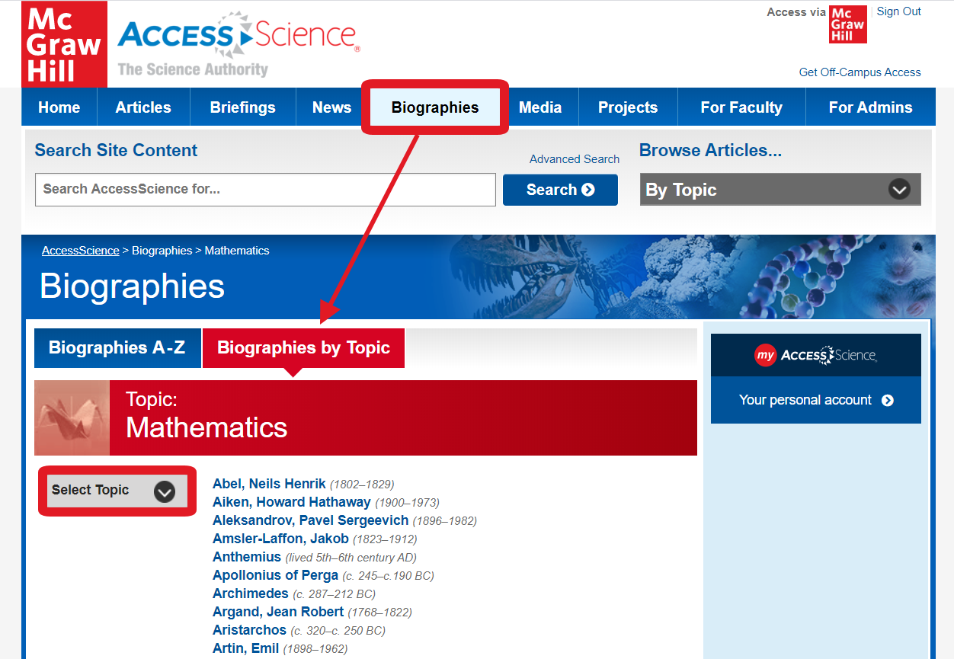
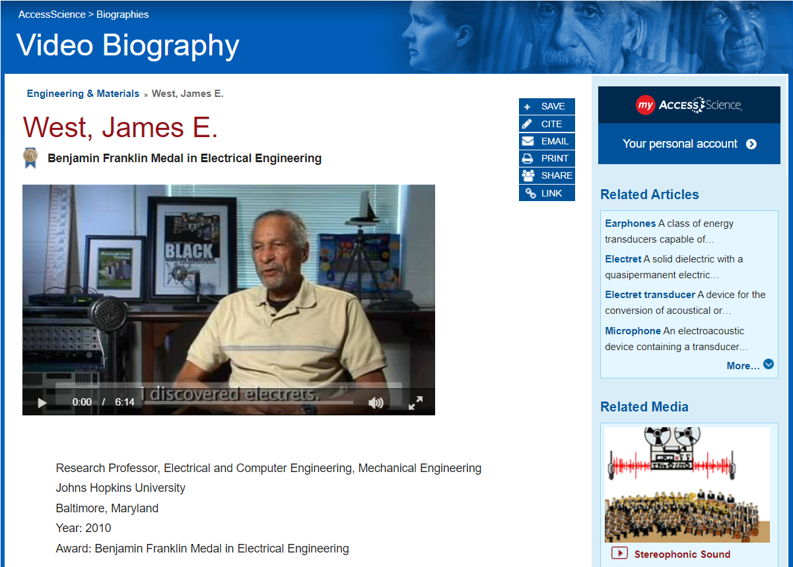
Engaging Multimedia
Explore the life and work of esteemed scientists with text and video biographies
AccessScience.com
Notes:
[Click on BIOGRAPHIES tab, select a TOPIC, and open a BIOGRAPHY:]
Biological Sciences/Health Sciences= TOPIC= Psychiatry & Psychology; VIDEO= Newport, Elissa L.
Physical Sciences= TOPIC= Mathematics; VIDEO= Daubechies, Ingrid
AccessScience contains over 3,000 TEXT biographies covering well-known scientific figures, as well as VIDEO biographies of contemporary award-winning scientists.
The VIDEO biographies are all under 6 minutes long, and cover not only the scientist’s background and major works but also how they got interested in science and the path they took, featuring perspectives from a diverse range of scientists.
PAIN POINT: Faculty & librarians are often looking for resources to explain the history of science or technology, or for resources featuring modern-day scientists for students exploring various career paths.

Slide 12
AccessScience tools and functionalities make it easy to find and incorporate resources in your teaching and learning.
Notes:
4. Instructional Support
AccessScience contains specially designed features to help faculty incorporate materials into their courses and to help students fully utilize these resources.
PAIN POINT: Faculty & librarians need resources that help make their jobs easier. AccessScience is a teaching tool and supports faculty by making it easy to find, use, and incorporate resources.

Slide 13
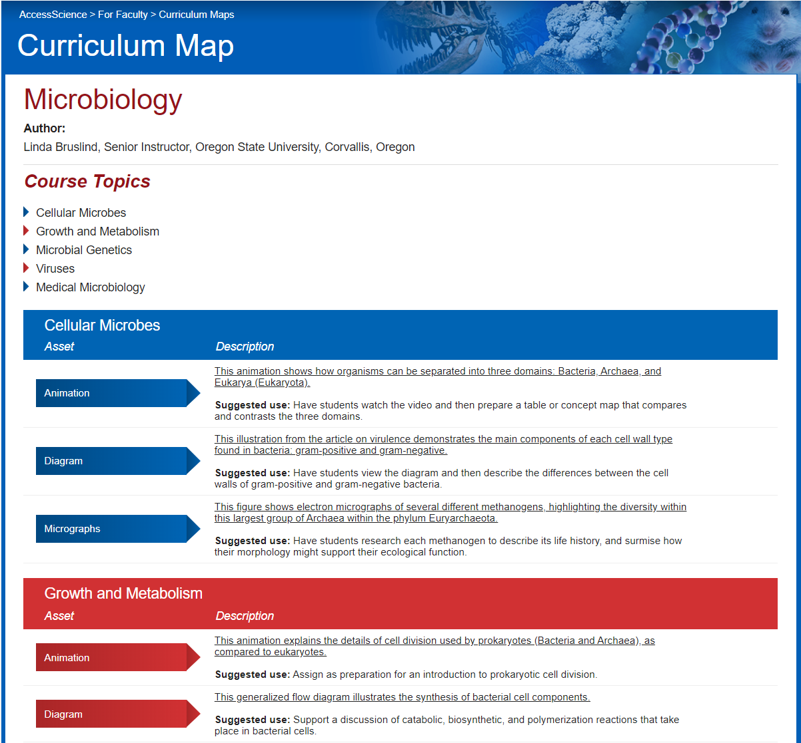
Instructional Support
Find specific content items for popular courses using Curriculum Maps
AccessScience.com
Notes:
[Click FOR FACULTY tab and open a CURRICULUM MAP:]
Biological Sciences/Health Sciences= Genetics
Physical Sciences= Astronomy
The FOR FACULTY tab contains resources specifically for faculty to help incorporate AccessScience resources into your teaching.
AccessScience CURRICULUM MAPS were developed by college science instructors and provide direct links to tables, graphs, diagrams, and other useful content tied to standard topics in a course outline. Most links also contain suggested uses for including these resources in learning activities.
The COPY LINK button to the right of each listed asset allows faculty to easily link to content from their learning management system.
PAIN POINT: Faculty are often overwhelmed by the volume of available resources, they want to be able to easily see what’s available for their course topics and be able to easily share resources with students.

Slide 14
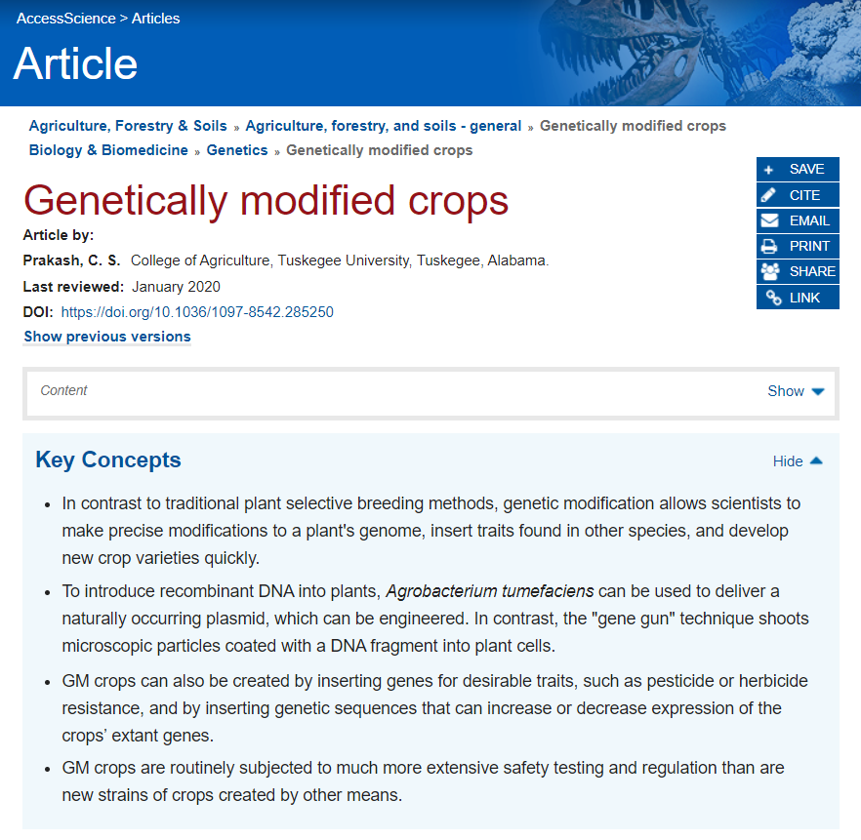
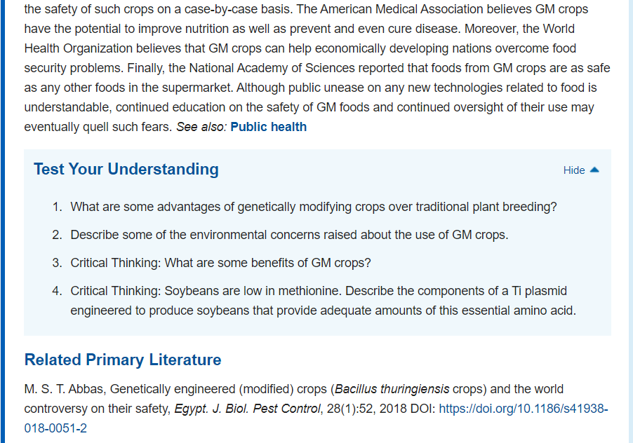
Instructional Support
Guide learning with Key Concepts and Test Your Understanding questions
AccessScience.com
Notes:
[From the MAP in the previous slide, click on the following ASSET to open an article:]
Biological Sciences/Health Sciences= COURSE TOPIC= Structure of Genetic Material; ASSET= Diagram “This figure from the article on DNA…”
Physical Sciences= COURSE TOPIC= The Earth-Moon System; ASSET= Map “This map of the far side of the Moon…”
[SCROLL to the top of the article to show the KEY CONCEPTS section, then scroll to the end to show the TEST YOUR UNDERSTANDING section]
ARTICLES contain several features to guide student learning, including KEY CONCEPTS and TEST YOUR UNDERSTANDING questions.
KEY CONCEPTS describe the major points that students should be able to identify from reading the article content and helps to focus learning.
At the end of some articles, a TEST YOUR UNDERSTANDING self-assessment section provides critical thinking questions to reflect on what was learned.
A link to answers for the Test Your Understanding questions can be found on the FOR FACULTY tab.
PAIN POINT: Faculty are often looking for resources that help with creating assignments, or for resources to point students to for self-directed learning.

Slide 15
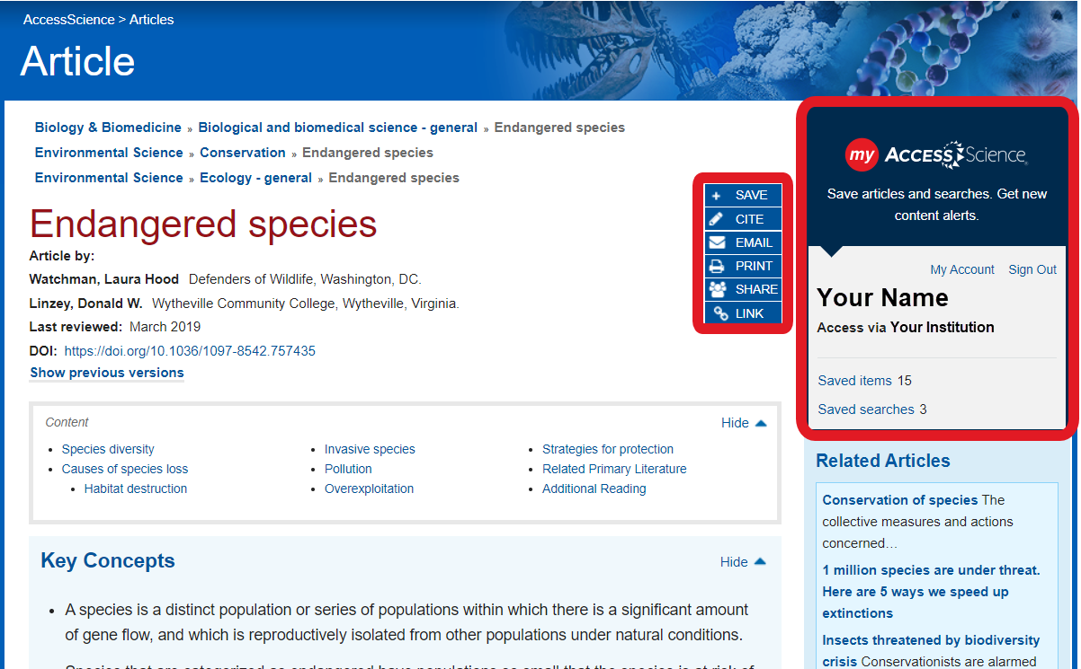
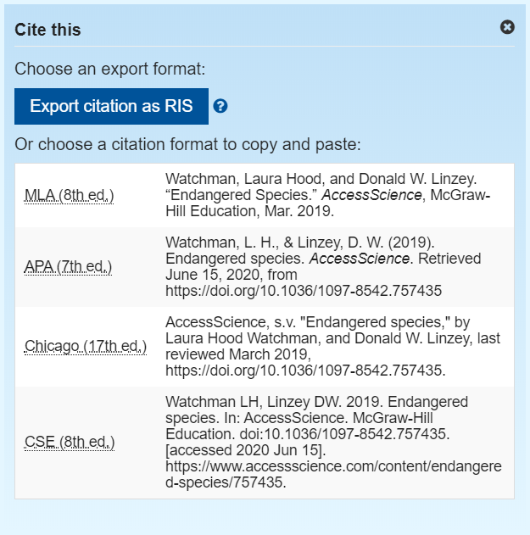
Instructional Support
Generate citations instantly and easily share or save content
AccessScience.com
Notes:
[In the ARTICLE from the previous slide, scroll up to the top to point out TOOLS]
All content on AccessScience has TOOLS available to support users. These blue buttons appear on every content page and allow users to easily generate a citation (CITE), share a link to the content via email (EMAIL), social media (SHARE), or copying a direct link (LINK). Users can also print a copy of the content for offline use (PRINT) or save the item to their personal My AccessScience account (SAVE).
A MY ACCESSSCIENCE personal account is a free optional feature that allows users to save specific items to refer to later, save searches to run again, and sign up for email alerts when new content is added. You can register for a personal account from any page using the My AccessScience widget at the top of the right sidebar. When signed in, this widget will allow you to view how many saved items and searches you have, and can be used to link over to view these items in your account.
PAIN POINT: Faculty & librarians are often looking for resources that are easy to share with students and that help students to appropriately cite their sources. Faculty & librarians are often hesitant to create additional personal accounts, and AccessScience does not require a personal account to use the site and resources, a personal account is just an added feature to more easily organize resources.

Slide 16
AccessScience supports librarians with administrative features and outreach resources to help your institution get the most from your subscription.
Notes:
5. FOR LIBRARIANS
AccessScience has resources for librarians to help support users on the site and to promote the site to your institution.
PAIN POINT: Librarians are often looking for support in creating awareness around available resources and how to use those resources.

Slide 17
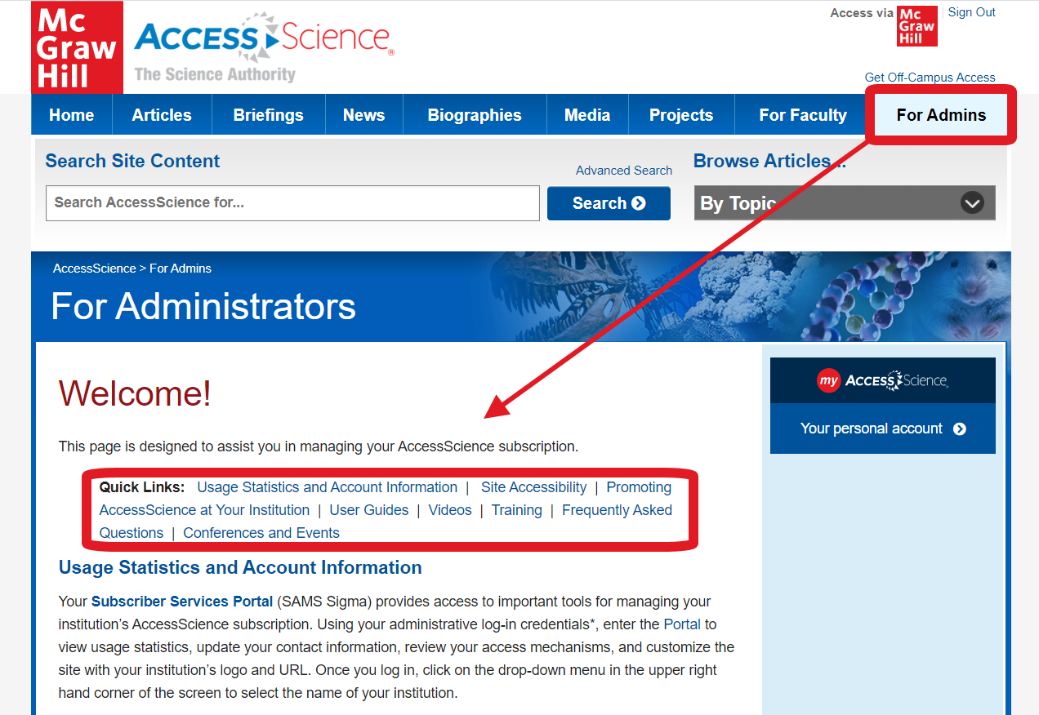
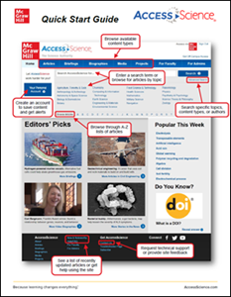
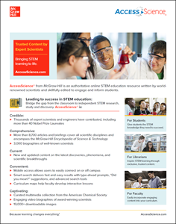
Librarian Support
Use promotional materials to create awareness of AccessScience and direct users to our guides and video tutorials for tips on using the site to it’s full potential
AccessScience.com
Notes:
[Open the FOR ADMINS tab, Scroll down to show the PROMOTING section and the USER GUIDES and VIDEOS sections]
The FOR ADMINS tab contains resources specifically to help librarians administer their institutional account and help their users make the most of AccessScience.
PROMOTIONAL materials such as flyers, email templates, web banners, and more are available to help announce a new subscription or remind faculty and students of resources available to them.
GUIDES and VIDEO tutorials can be shared to answer user questions and to help faculty and students fully utilize the resources available on the site.
PAIN POINT: Librarians are often looking for materials to help with getting their institution to know about and use digital resources.

Slide 18
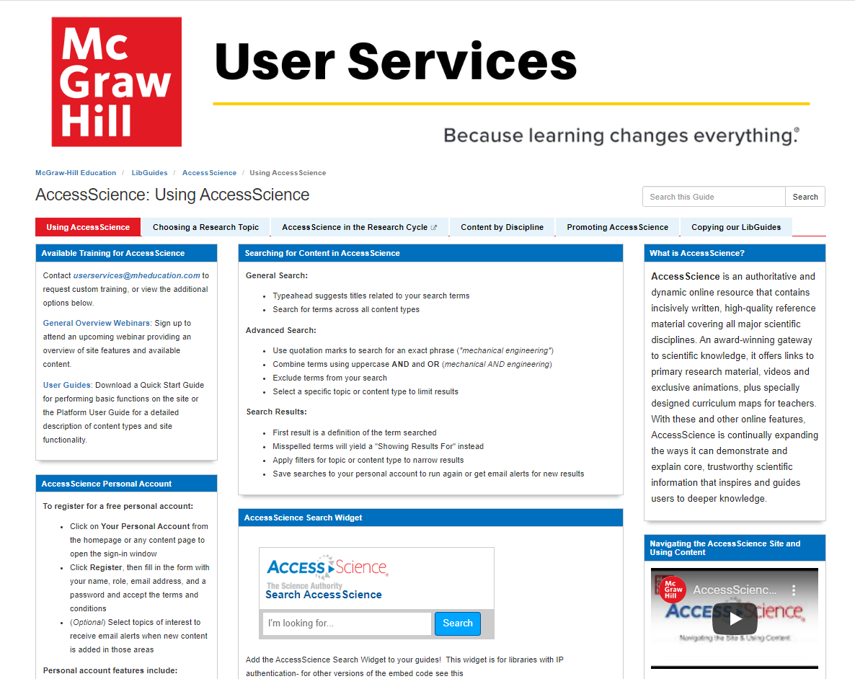
Librarian Support
See resources available on the AccessScience LibGuide and incorporate into your own guides
AccessScience.com
Notes:
[On the FOR ADMINS tab, scroll down and use the link to open the AccessScience LIBGUIDE, then click through the various tabs on the GUIDE]
The AccessScience LIBGUIDE also contains information on the site, available content, and tips for use, in a familiar format that can easily be incorporated into other LibGuides.
The LIBGUIDE also contains a sampling of content for the major science disciplines, and research topic suggestions and help for students navigating a research paper or project.
PAIN POINT: Librarians need resources in various formats to reach their users. Many libraries use the Springshare LibGuide platform for research guides, and can easily link to the AccessScience guide or reuse any piece of it in their own guides.

Slide 19
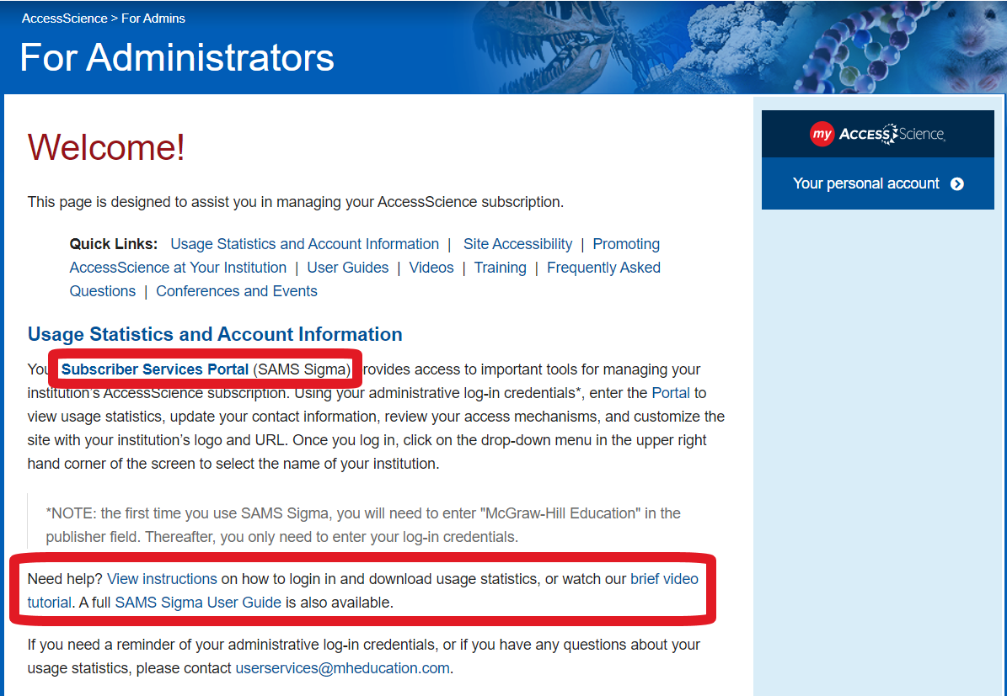
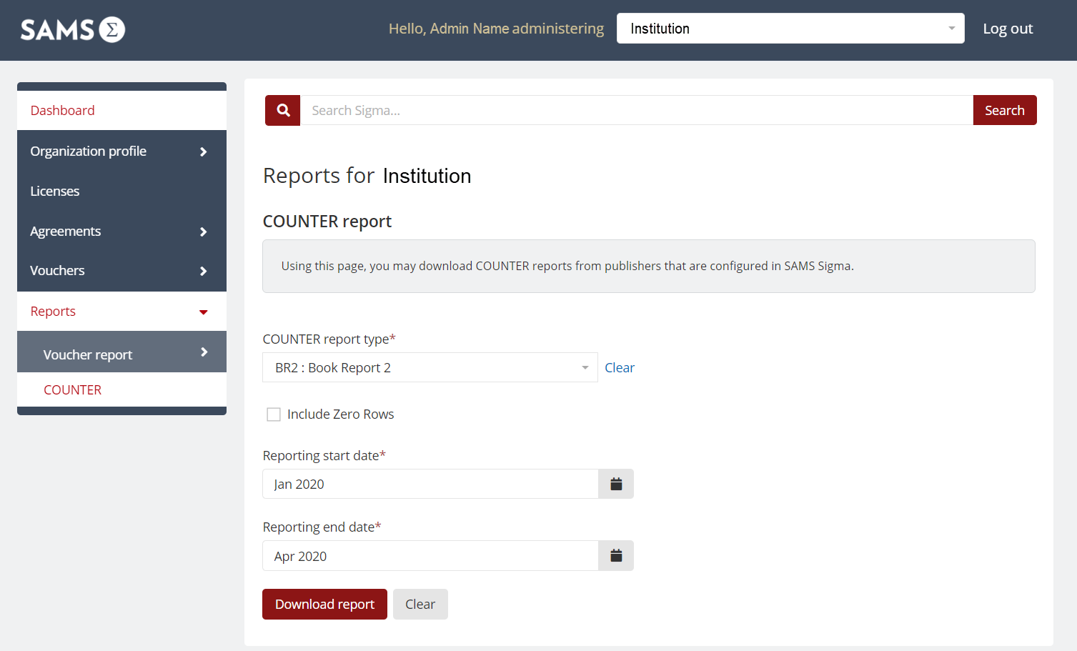
Librarian Support
Monitor site usage and customize the site with your institution's logo and OpenURL information
AccessScience.com
Notes:
[On the FOR ADMINS tab, show the USAGE STATISTICS section at the top of the page]
Librarians can monitor their institutions usage statistics and customize their AccessScience site with their institution’s URL to let users know that they have access via their library’s subscription.
Librarians can also set up an OpenURL connection to display next to any link to external articles on the site for seamless access to other library provided resources.
PAIN POINT: Librarians often need to be able to stay updated on resource usage and want to be able to manage aspects of their subscription themselves. Librarians also often want to be able to include their own branding so that they are more visible to users; it is important that users are aware that resources are being provided through their library.

Slide 20

Brings STEM Learning to Life
AccessScience.com
[Insert image here of sales rep]
For more information or to request a free trial, please contact your local sales representative at name@mheducation.com

Slide 21
Tips for Preparing for Your Presentation

Slide 22
Tips for Preparing for Your Presentation
Questions to Consider:
What products are they using now?
Are they currently using any digital resources?
Why do they need this?
Can our products help save them time, save them money, or make their lives easier?
What problem are we solving?
What problem do you think they have?
How can McGraw Hill help?
AccessScience.com

Slide 23
Tips for Preparing for Your Presentation
Information to Gather:
See what resources their library has now
Review everything on the website about the program you’re meeting and recent news related to the program
See what their adopted textbooks are (by entering individual courses into the bookstore site)
Review usage statistics and especially review access denied stats if they have a current subscription or prior trial
Know your numbers – research enrollments, research exam scores/graduation rates, have a history of what they’ve been quoted, and know your own penetration numbers (i.e. 50% of programs in New York currently use XYZ)
AccessScience.com

Slide 24
Tips for Preparing for Your Presentation
Additional Tips:
Familiarize yourself with the faculty and their background. This could come in handy. For example, if you know the Chair of a program graduated from NYU. Then you can sprinkle in the fact that NYU is currently using this to help establish credibility and buy-in.
Rehearse your presentation at least five times out loud and standing. This will help you not only identify potential places you’ll get hung-up, but it’ll reinforce the phrasing you’d like to use.
AccessScience.com
Notes:
FOR INTERNAL USE ONLY

